Slide 1
Flux Interval of Time duration

Slide 2
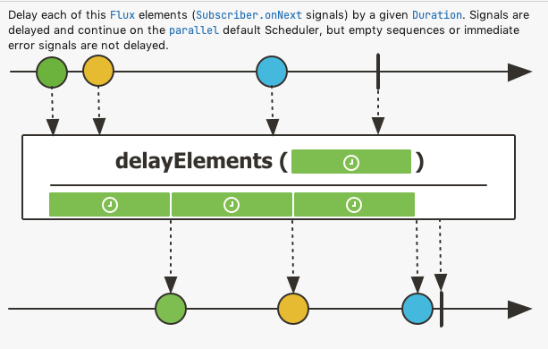
DelayElements
Consider you have situation where you want to publish each element after a after a particular duration, then delayElements method will help to achieve it.
So each onNext call will have a specified time duration.
After the delay is complete the next element will be executed by parallel Scheduler not by the same Main thread.
If Flux is empty or it throws any error signal will be sent immediately and it does not follow the time specified in delayElements method.

Slide 3
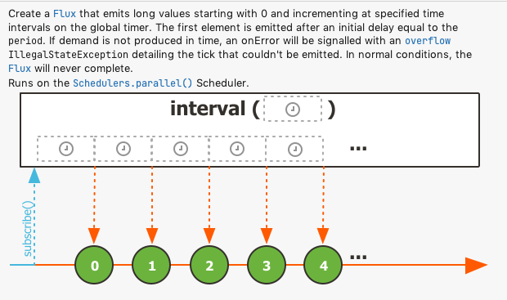
Interval
Consider you have situation where you want to create the Flux that emit long value starting to 0 to and incrementing at specified time intervals on the global timer.
The first element is emitted after an initial delay equal to the period.
If demand is not produced in time, an onError will be signaled with an overflow IllegalStateException detailing the tick that couldn't be emitted.
In normal conditions, the Flux will never complete that is emit long starting from 0 to N elements.

